Slide 1

What’s new in ASP.NET Core 3.0
Scott Addie
@Scott_Addie

Slide 2


.NET Framework unsupported
WebApp.csproj
<Project Sdk="Microsoft.NET.Sdk.Web"> <PropertyGroup> <TargetFramework>netcoreapp3.0</TargetFramework> </PropertyGroup> </Project>
Notes:
ASP.NET Core 3.0 built on .NET Standard 2.1

Slide 3
Supported ASP.NET Core variants
3.0 on .NET Core 3.0
2.2 on .NET Core 2.2
2.1 on .NET Core 2.1
2.1 on .NET Framework 4.6.x
Current
Maint.
LTS
LTS
Notes:
3.1 = LTS

Slide 4
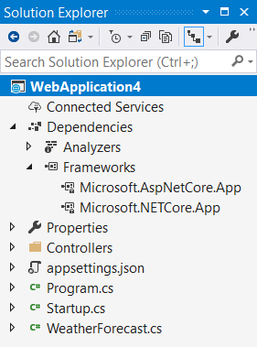
Implicit Shared Framework reference
Web SDK includes the following:
<ItemGroup>
<FrameworkReference Include="Microsoft.AspNetCore.App" />
</ItemGroup>
Remove metapackage reference when migrating:
<ItemGroup>
<PackageReference Include="Microsoft.AspNetCore.App" />
</ItemGroup>

Slide 5

Episode III
A NEW RELEASE
It is a period of assembly removal from the ASP.NET Core shared framework. Caffeinated engineers, working from a building in Redmond, have made tough decisions…
Notes:
Remove things the ASP.NET Core team doesn’t own:
Azure SDK
EF Core

Slide 6

Assemblies removed from Shared Framework
Json.NET
Roslyn (Microsoft.CodeAnalysis.*)
EF Core
Social auth
Node Services & SPA Services
Notes:
Roslyn:
ships on the VS schedule, which differs from the .NET Core release lifecycle
some customers don’t want compilers in there for security reasons
Social auth: Facebook, Google, Microsoft, Twitter

Slide 7
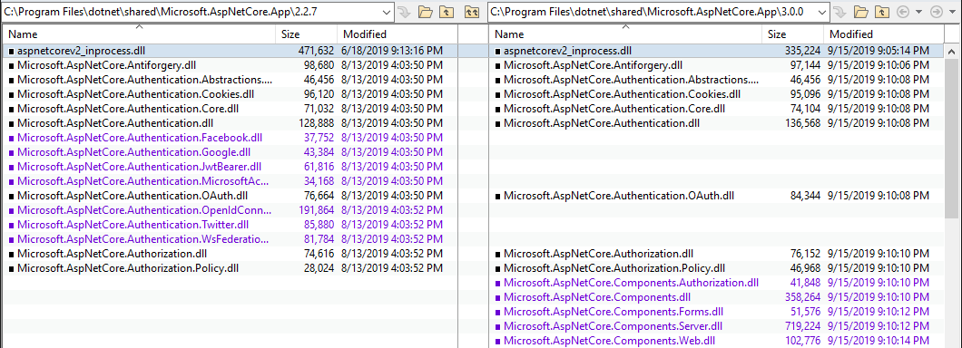
Shared Framework: 2.2 vs. 3.0

Slide 8
C# 8 support
[HttpGet("asyncsale")]
public async IAsyncEnumerable<Product> GetOnSaleProductsAsync()
{
var products = _repo.GetProductsAsync();
await foreach (var product in products)
{
if (product.IsOnSale)
{
yield return product;
}
}
}
Notes:
GetProductsAsync returns an IAsyncEnumerable<Product>
This is a non-blocking action as of 3.0
MVC buffers any concrete type that implements IAsyncEnumerable<T> before sending it to the serializer

Slide 9
System.Text.Json

Slide 10
Endpoint routing

Slide 11
HTTP REPL

Slide 12
Developer Exception Page plain text support

Slide 13
SignalR automatic reconnects

Slide 14
global.json enhancements
dotnet --roll-forward <setting>
LatestPatch
Minor
LatestMinor
Major
LatestMajor
Disable
Notes:
New roll-forward behaviors

Slide 15
Demo intro slide

